Slide 1
Analyzing Algorithms
Session 03
Henry Lucky, S.Kom. M.Kom.

Slide 2
Outline Materials
Session 03
Insertion Sort
Analysis of Insertion Sort
Order of Growth
Divide and Conquer method
Analyzing divide and conquer algorithms

Slide 3
Learning outcomes
03
LO 1: Explain fundamental concept of analysis algorithms
LO 2: Apply algorithm techniques and methods
LO 3: Solve a problem using specific algorithm.
LO 4: Compare several algorithm design methods

Slide 4
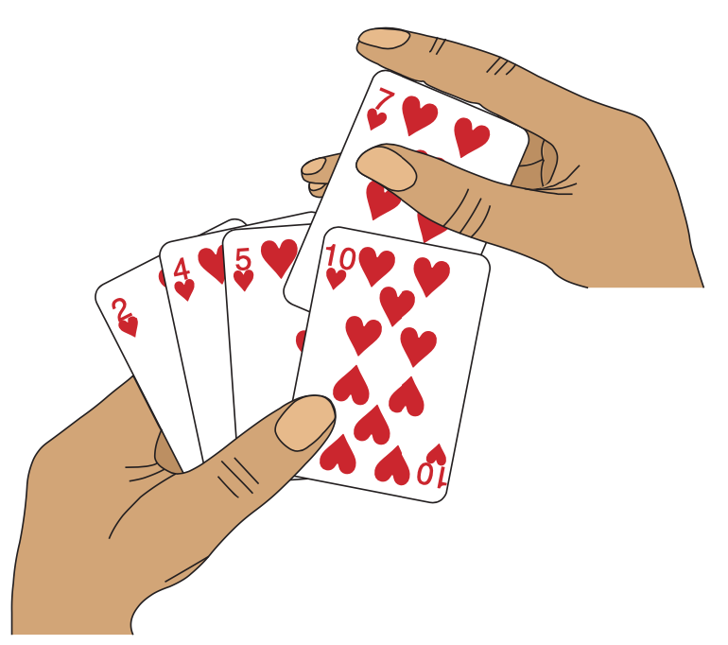
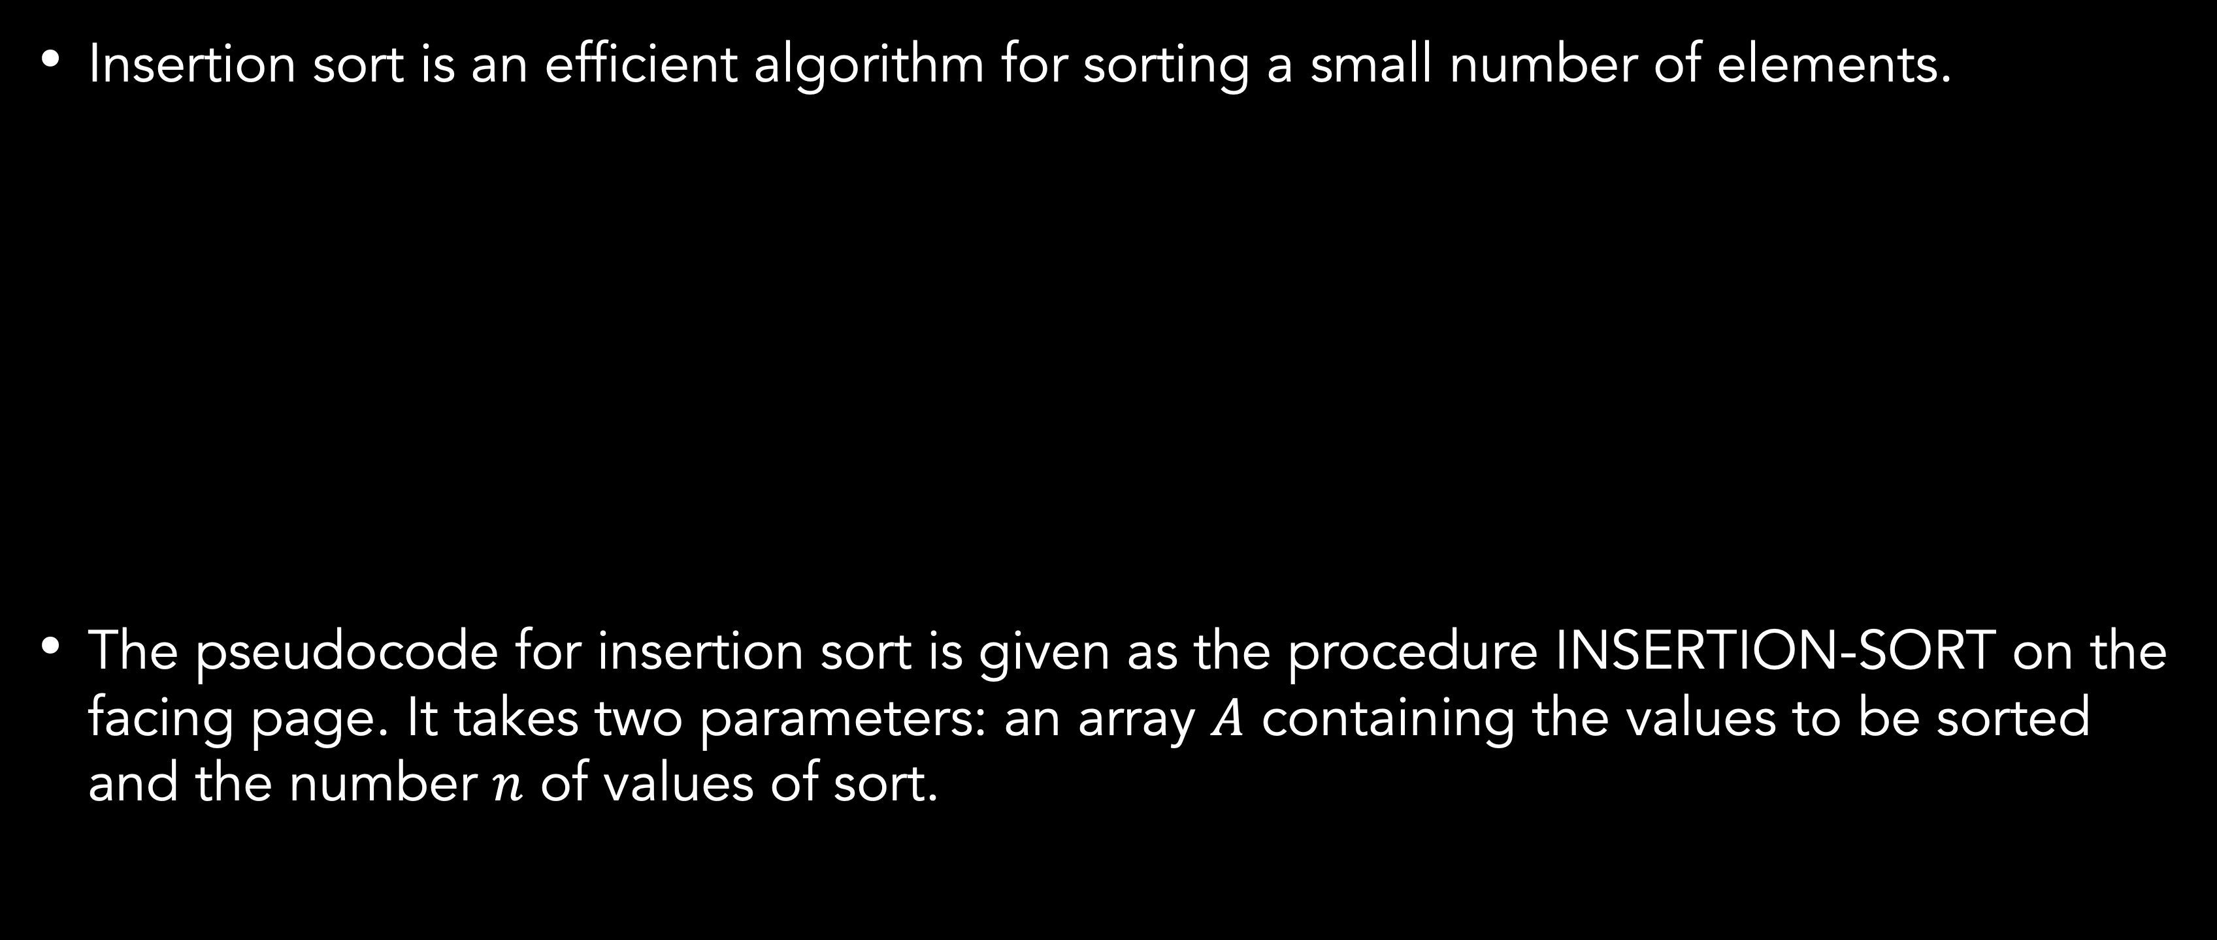
Insertion sort
Definition
Insertion sort is an efficient algorithm for sorting a small number of elements.
The pseudocode for insertion sort is given as the procedure INSERTION-SORT on the facing page. It takes two parameters: an array $A$ containing the values to be sorted and the number $n$ of values of sort.

Slide 5
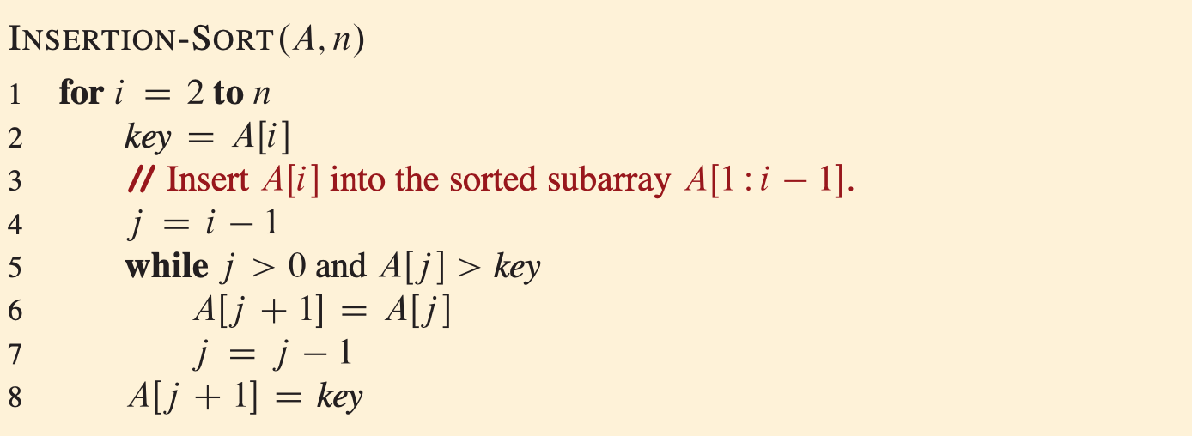
Insertion sort
Pseudocode

Slide 6
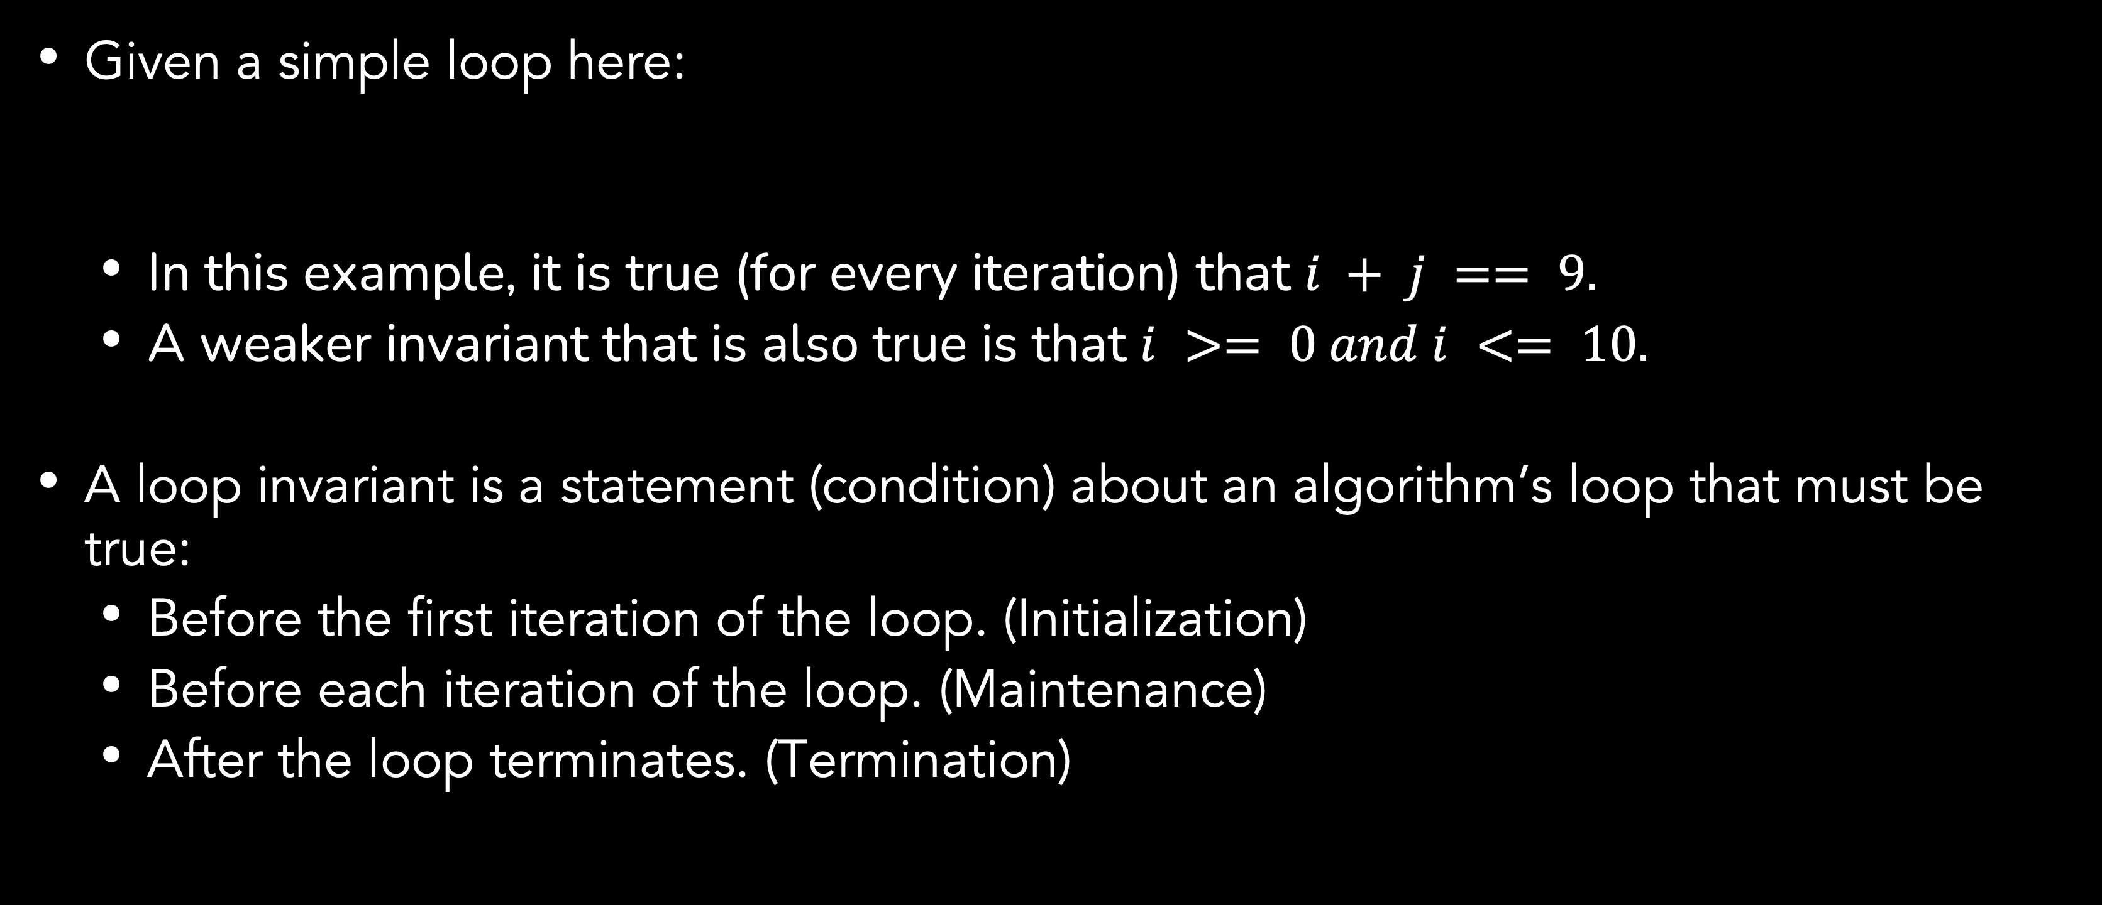
Insertion sort
Proving Correctness with loop invariants
Given a simple loop here:
In this example, it is true (for every iteration) that $i + j == 9.$
A weaker invariant that is also true is that $i >= 0 and i <= 10.$
A loop invariant is a statement (condition) about an algorithm’s loop that must be true:
Before the first iteration of the loop. (Initialization)
Before each iteration of the loop. (Maintenance)
After the loop terminates. (Termination)
int j = 9;
for(int i=0; i<10; i++) j--;

Slide 7
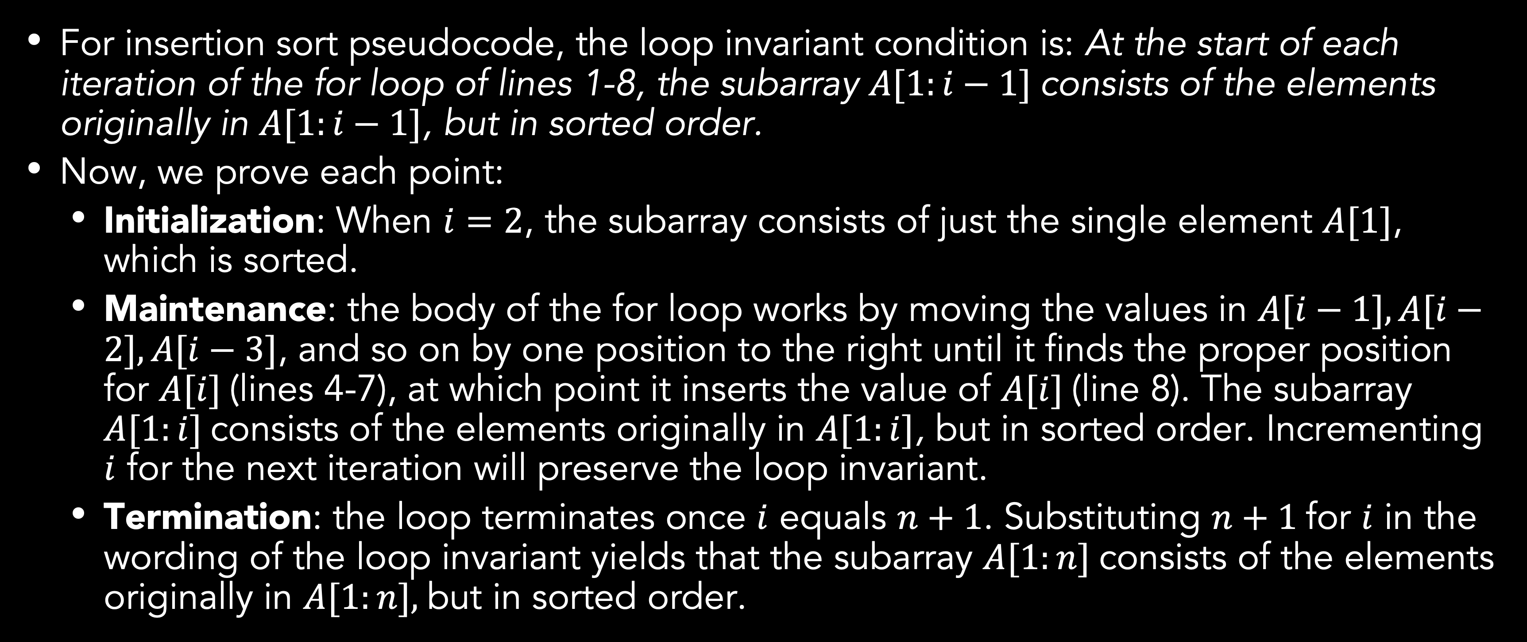
Insertion sort
Proving Correctness with loop invariants
For insertion sort pseudocode, the loop invariant condition is: At the start of each iteration of the for loop of lines 1-8, the subarray $A[1:i−1]$consists of the elements originally in $A[1:i−1]$, but in sorted order.
Now, we prove each point:
Initialization: When $i=2$, the subarray consists of just the single element $A[1]$, which is sorted.
Maintenance: the body of the for loop works by moving the values in $A[i−1], A[i−2], A[i−3]$, and so on by one position to the right until it finds the proper position for $A[i]$(lines 4-7), at which point it inserts the value of $A[i]$(line 8). The subarray $A[1:i]$consists of the elements originally in $A[1:i]$, but in sorted order. Incrementing $i$ for the next iteration will preserve the loop invariant.
Termination: the loop terminates once $i$ equals $n+1$. Substituting $n+1$for $i$ in the wording of the loop invariant yields that the subarray $A[1:n]$consists of the elements originally in $A[1:n],$but in sorted order.

Slide 8
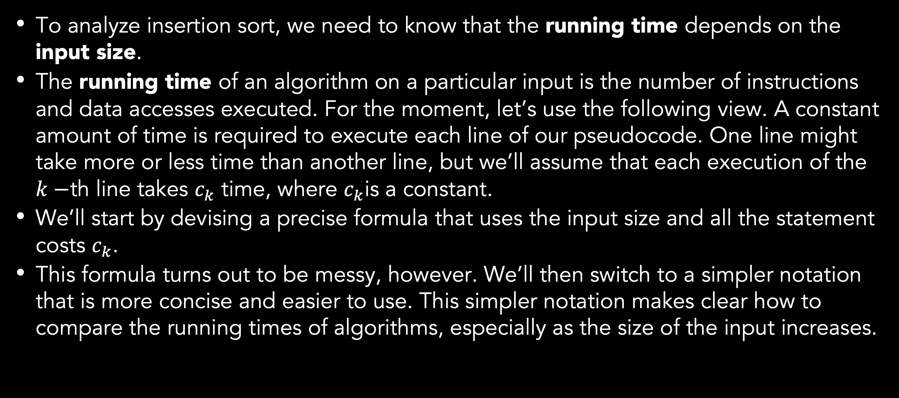
Analyzing insertion sort
To analyze insertion sort, we need to know that the running time depends on the input size.
The running time of an algorithm on a particular input is the number of instructions and data accesses executed. For the moment, let’s use the following view. A constant amount of time is required to execute each line of our pseudocode. One line might take more or less time than another line, but we’ll assume that each execution of the $k−$th line takes $c_{k}$ time, where $c_{k}$is a constant.
We’ll start by devising a precise formula that uses the input size and all the statement costs $c_{k}$.
This formula turns out to be messy, however. We’ll then switch to a simpler notation that is more concise and easier to use. This simpler notation makes clear how to compare the running times of algorithms, especially as the size of the input increases.

Slide 9
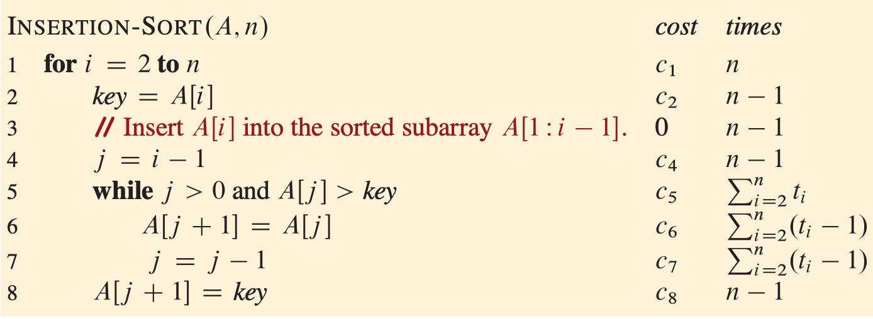
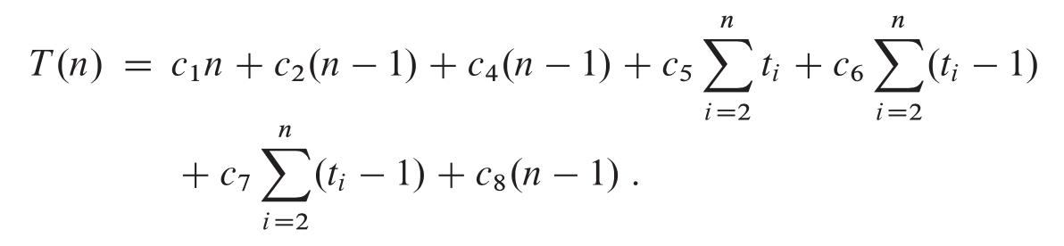
Analyzing insertion sort
Notes:
To analyze the INSERTION-SORT procedure, let’s view it on the following page with the time cost of each statement and the number of times each statement is executed. For each i=2, 3, …, n, let ti denote the number of times the while loop test in line 5 is executed for that value of i. When a for or while loop exits in the usual way (because the test in the loop header comes up FALSE) the test is executed one time more than the loop body (n times). Because comments are not executable statements, assume that they take no time.
The running time of the algorithm is the sum of running times for each statement executed. A statement that takes ck steps to execute and executes m times contributes to the total running time. We usually denote the running time of an algorithm on an input of size n by T(n). To compute T(n), the running time of INSERTION-SORT on an input of values, we sum the products of the cost and times columns.

Slide 10
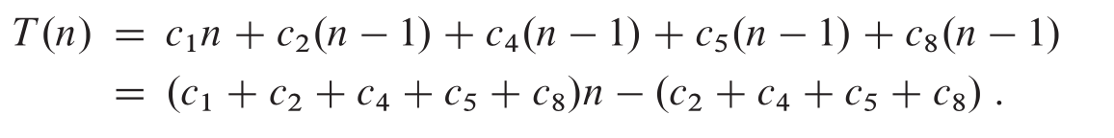
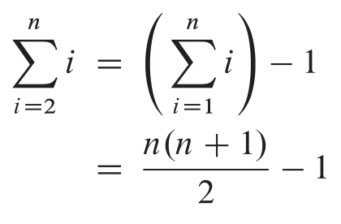
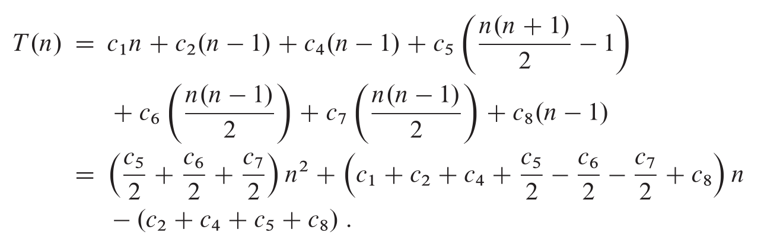
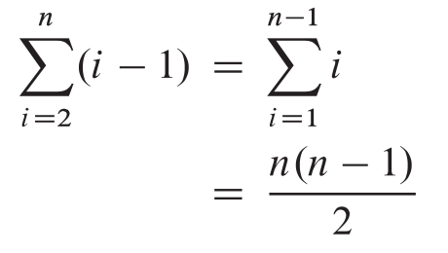
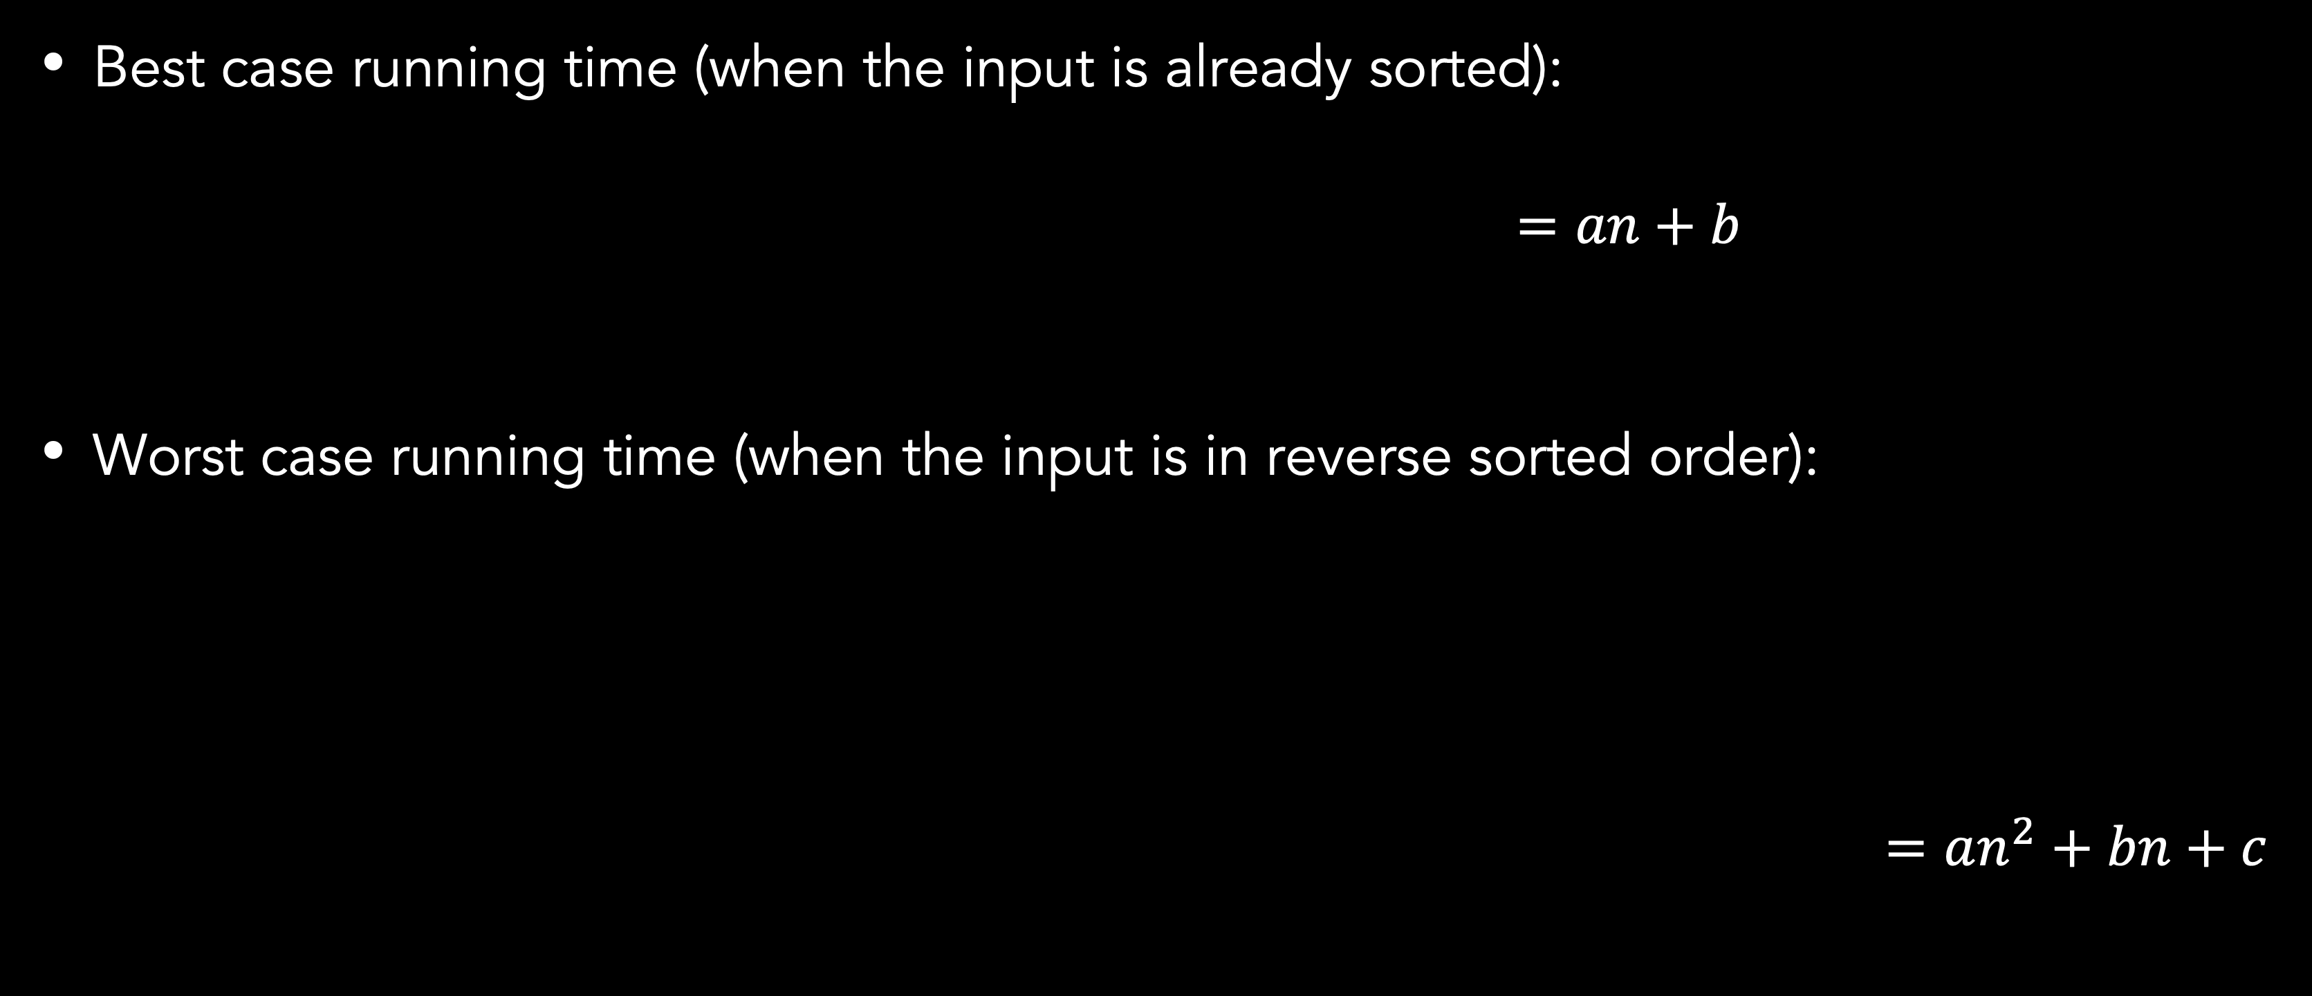
Analyzing insertion sort
Best case running time (when the input is already sorted):
$=an+b$
Worst case running time (when the input is in reverse sorted order):
$=an^{2}+bn+c$
Notes:
We can express the running time of best-case as linear function of n, an+b, with a = (c1+c2+c3+c4+c8) and b = (c2+c3+c4+c8)
We can express the running time of worst-case as quadratic function of n, an2+bn+c, with a = (c5/2+c6/2+c7/2), b = (c1+c2+c4+c5/2-c6/2-c7/2+c8) and c = -(c2+c4+c5+c8)

Slide 11
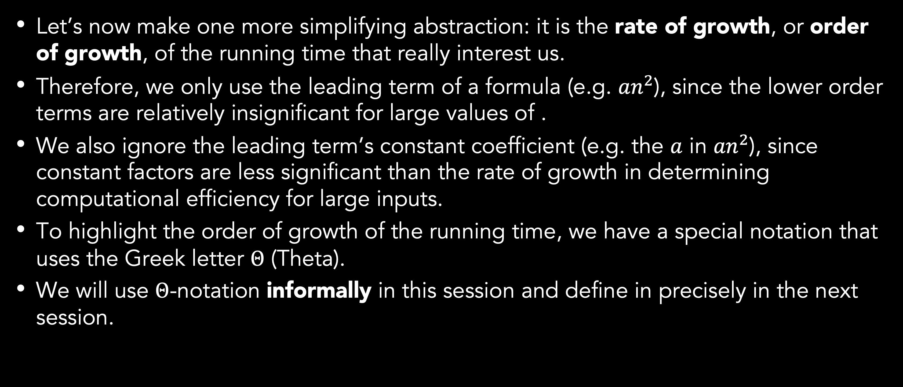
Order of growth
Let’s now make one more simplifying abstraction: it is the rate of growth, or order of growth, of the running time that really interest us.
Therefore, we only use the leading term of a formula (e.g. ${an}^{2}$), since the lower order terms are relatively insignificant for large values of .
We also ignore the leading term’s constant coefficient (e.g. the $a$ in ${an}^{2}$), since constant factors are less significant than the rate of growth in determining computational efficiency for large inputs.
To highlight the order of growth of the running time, we have a special notation that uses the Greek letter $Θ$ (Theta).
We will use $Θ$-notation informally in this session and define in precisely in the next session.

Slide 12
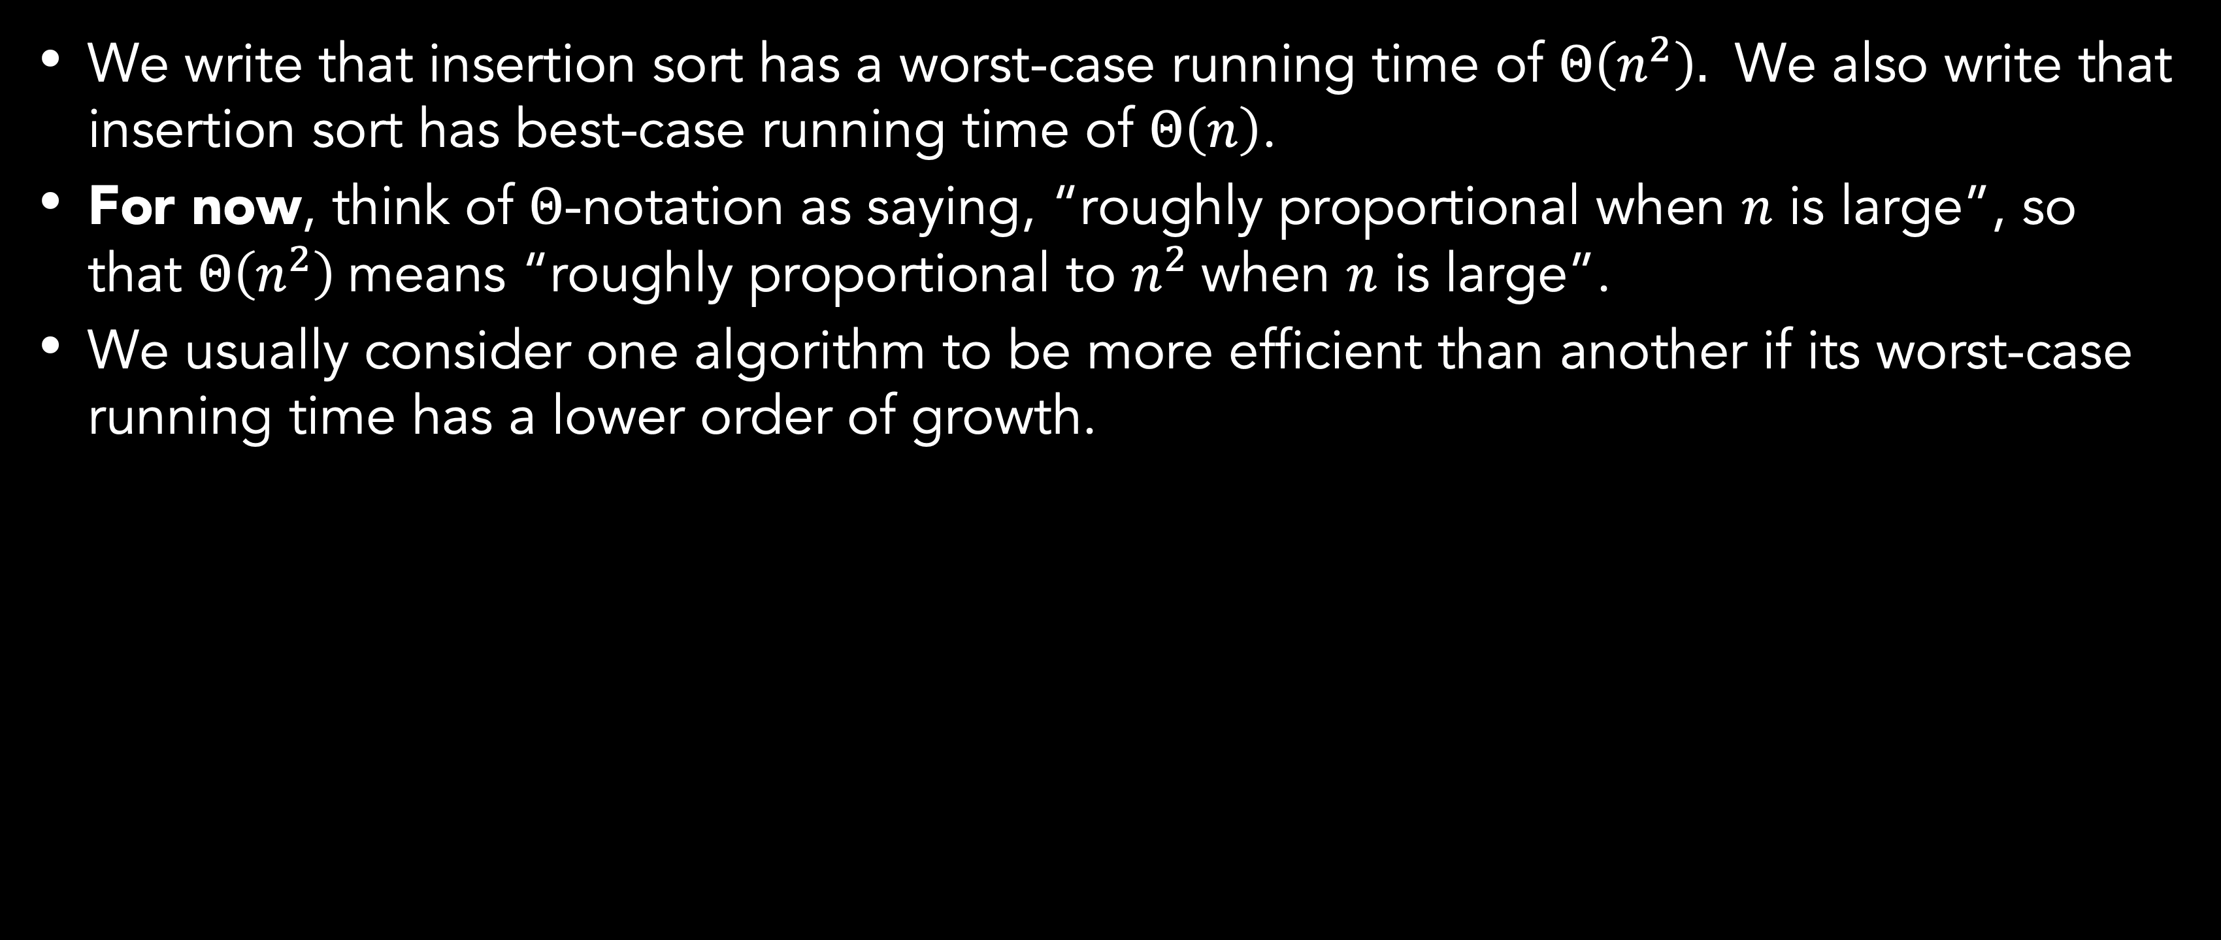
Order of growth
We write that insertion sort has a worst-case running time of $Θ\left(n^{2}\right).$ We also write that insertion sort has best-case running time of $Θ\left(n\right)$.
For now, think of $Θ$-notation as saying, “roughly proportional when $n$ is large”, so that $Θ\left(n^{2}\right)$means “roughly proportional to $n^{2}$when $n$ is large”.
We usually consider one algorithm to be more efficient than another if its worst-case running time has a lower order of growth.

Slide 13
Divide and conquer method
Divide-and-conquer method is recursive in structure: they break the problem into several subproblems that are similar to the original problem but smaller in size, solve the subproblems recursively, and then combine these solutions to create a solution to the original problem.
In the divide-and-conquer method, if the problem is small enough (the base case) you just solve it directly without recursing. Otherwise, (the recursive case) you perform three characteristic steps:
Divide the problem into one or more subproblems that are smaller instances of the same problem.
Conquer the subproblems by solving them recursively.
Combine the subproblem solutions to form a solution to the original problem.

Slide 14
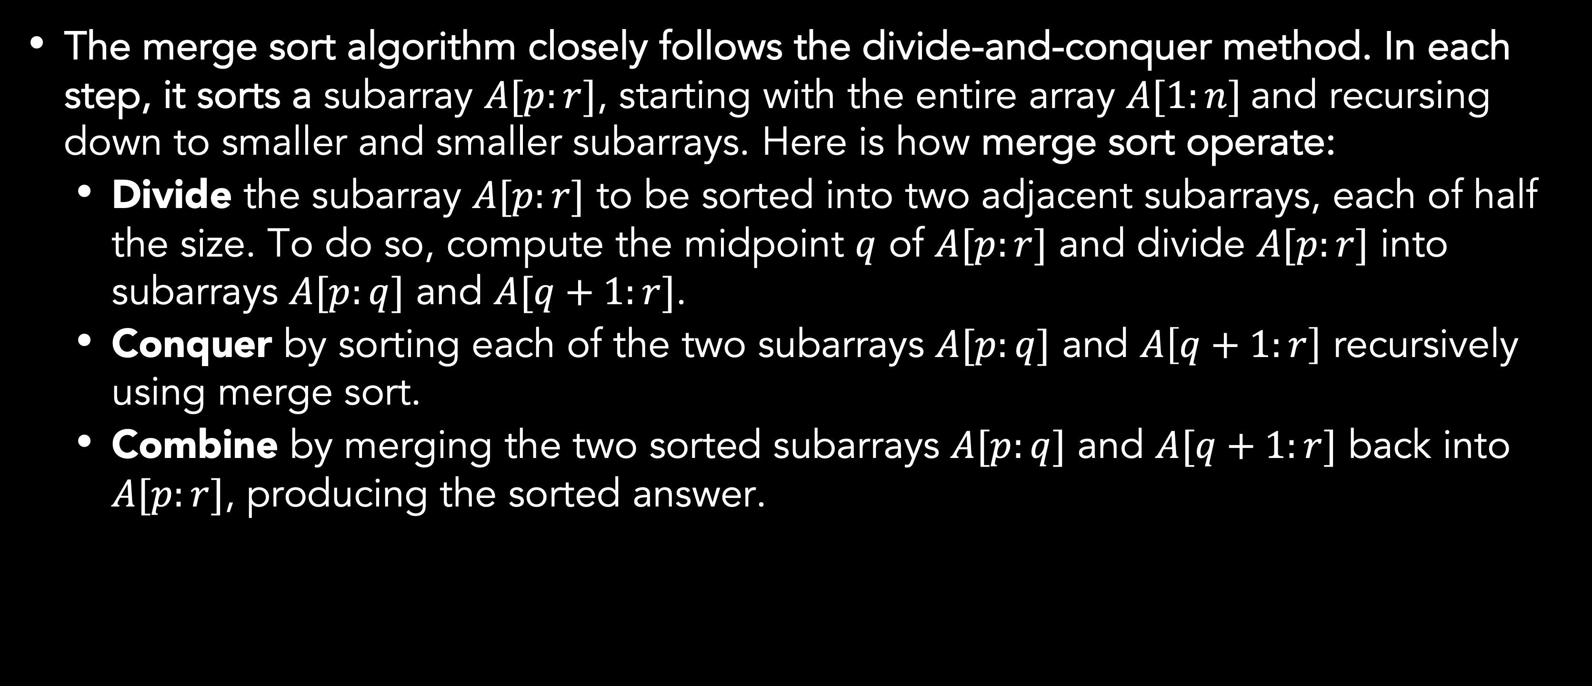
Divide and conquer method
Merge sort
The merge sort algorithm closely follows the divide-and-conquer method. In each step, it sorts a subarray $A[p:r]$, starting with the entire array $A[1:n]$and recursing down to smaller and smaller subarrays. Here is how merge sort operate:
Divide the subarray $A[p:r]$ to be sorted into two adjacent subarrays, each of half the size. To do so, compute the midpoint $q$ of $A[p:r]$ and divide $A[p:r]$ into subarrays $A[p:q]$ and $A[q+1:r]$.
Conquer by sorting each of the two subarrays $A[p:q]$ and $A\left[q+1:r\right]$ recursively using merge sort.
Combine by merging the two sorted subarrays $A[p:q]$ and $A[q+1:r]$ back into $A[p:r]$, producing the sorted answer.

Slide 15
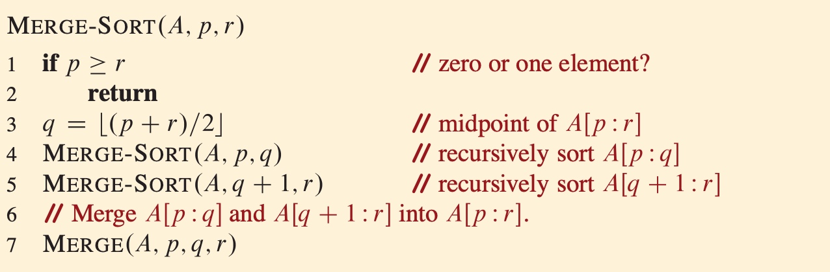
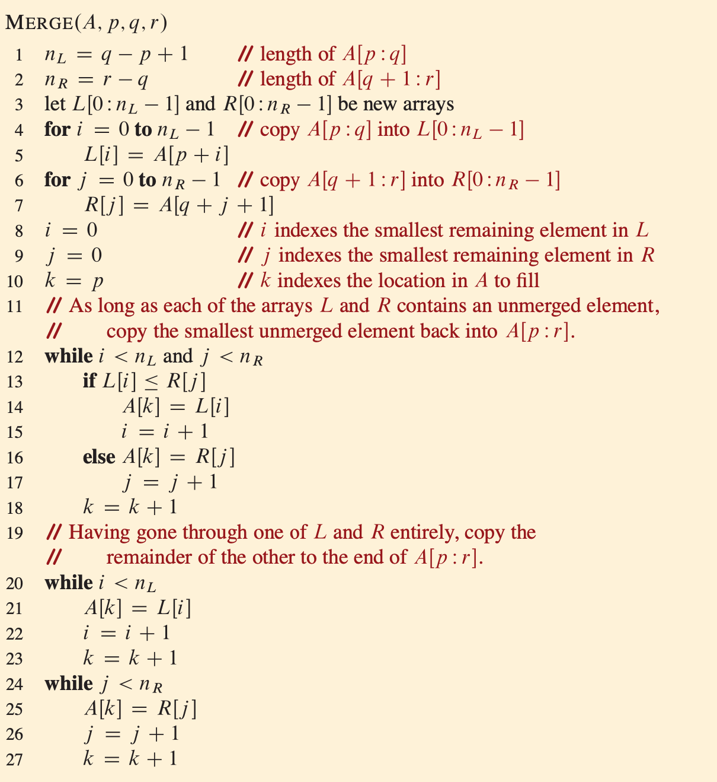
Divide and conquer method
Merge sort algorithm

Slide 16
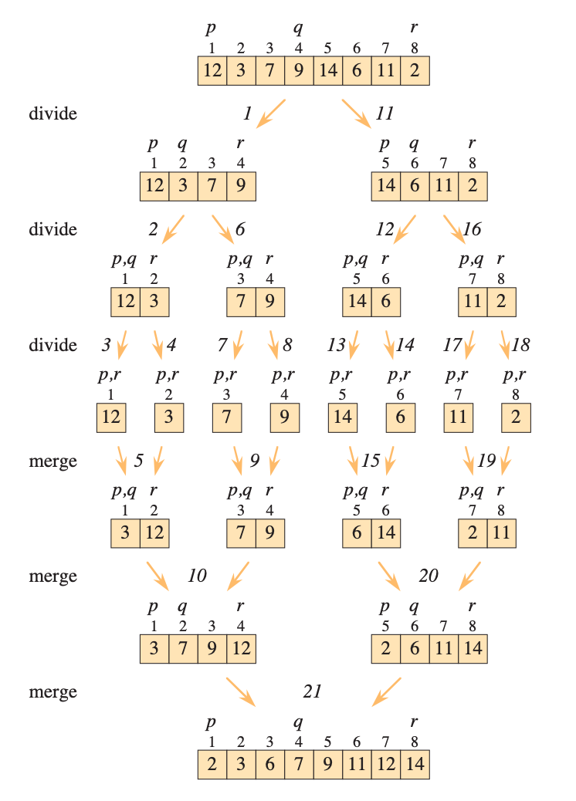
Divide and conquer method
Merge sort illustration

Slide 17
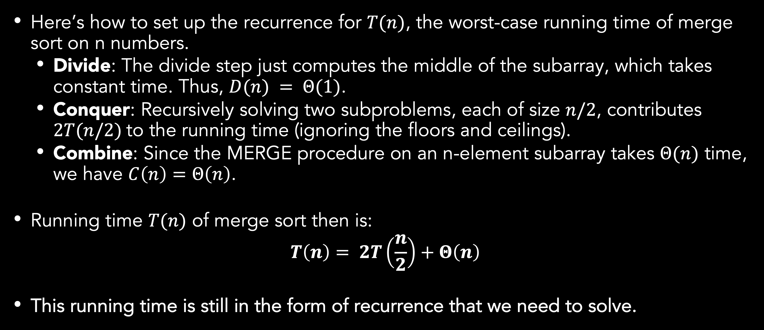
Analyzing Divide and conquer algorithms
Merge sort
Here’s how to set up the recurrence for $T(n)$, the worst-case running time of merge sort on n numbers.
Divide: The divide step just computes the middle of the subarray, which takes constant time. Thus, $D(n) = Θ(1)$.
Conquer: Recursively solving two subproblems, each of size $n/2$, contributes $2T(n/2)$to the running time (ignoring the floors and ceilings).
Combine: Since the MERGE procedure on an n-element subarray takes $Θ(n)$ time, we have $C\left(n\right)=Θ\left(n\right)$.
Running time $T(n)$ of merge sort then is:
$$T\left(n\right)= 2T\left(\frac{n}{2}\right)+Θ\left(n\right)$$
This running time is still in the form of recurrence that we need to solve.
Notes:
\Theta(n) + \Theta(1) is \Theta(n) because it is still roughly proportional to n when n is large.

Slide 18
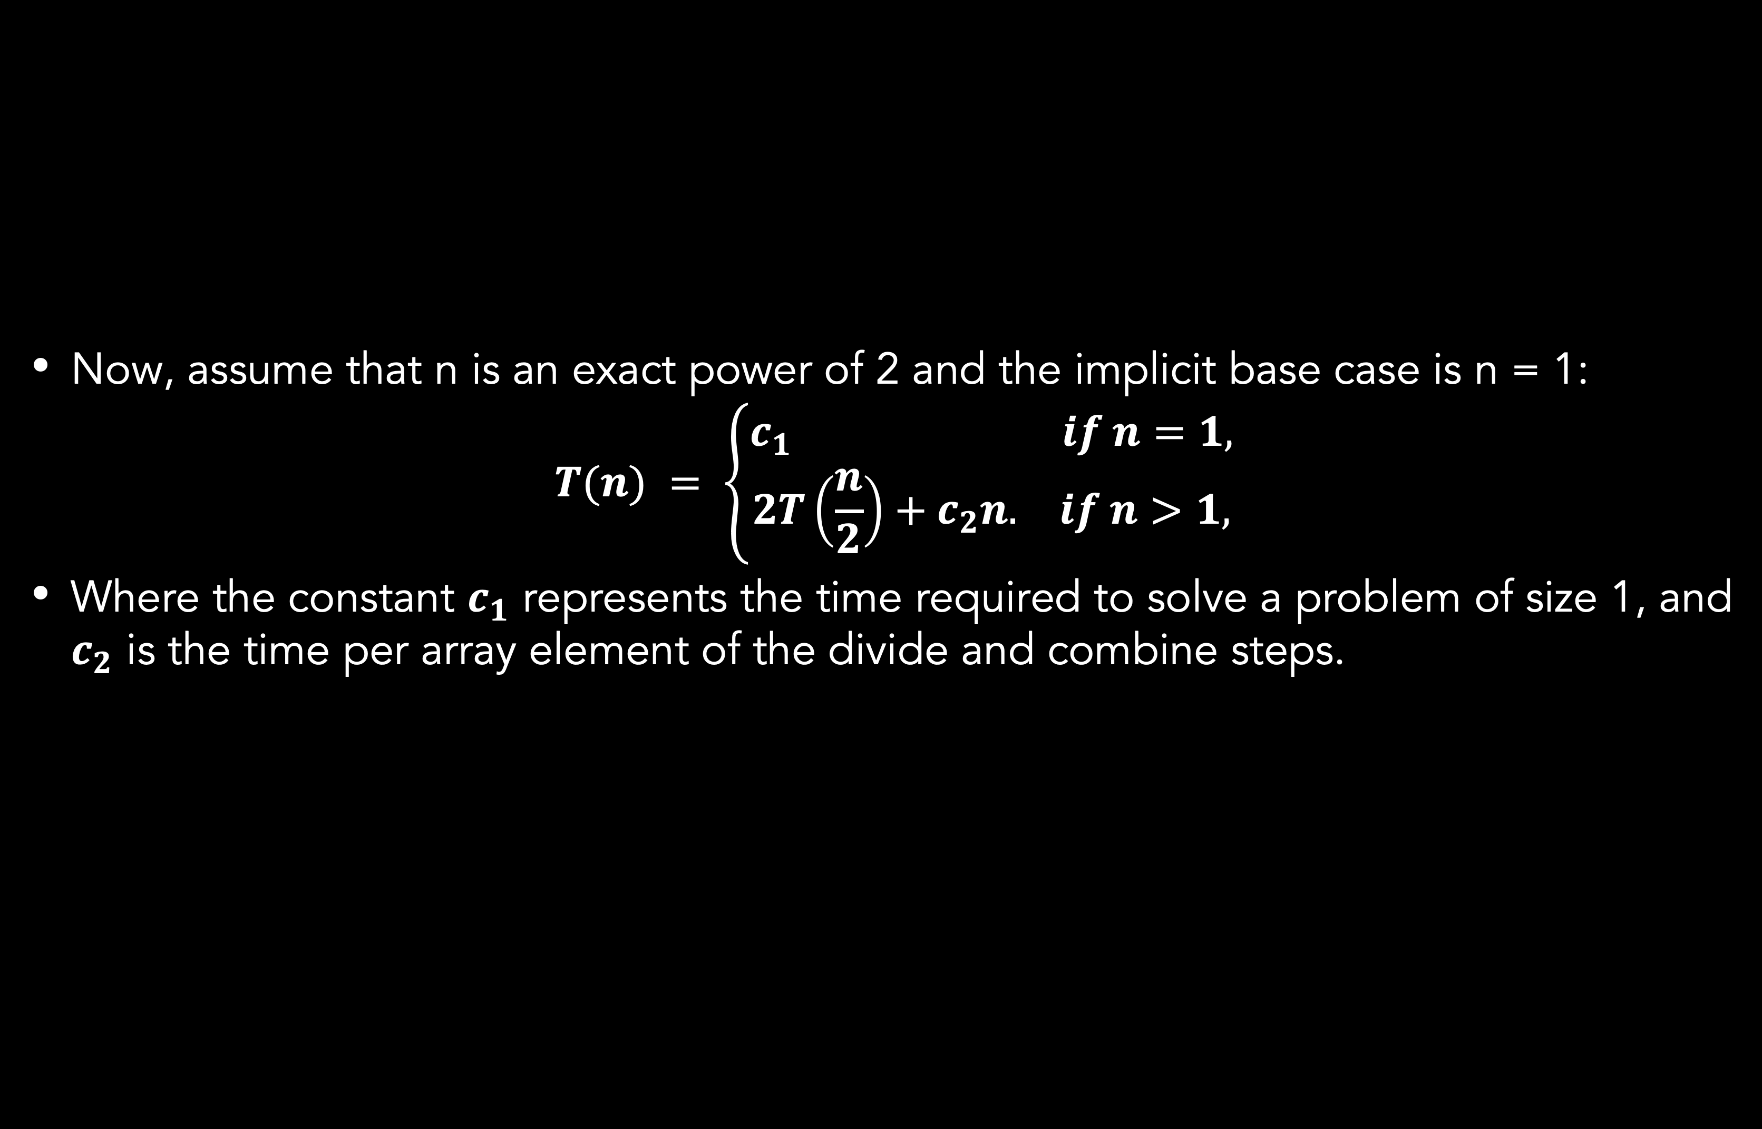
Analyzing Divide and conquer algorithms
Merge sort
Now, assume that n is an exact power of 2 and the implicit base case is n = 1:
$$T(n) = \left\{\begin{aligned}c_{1} if n=1, \\ 2T\left(\frac{n}{2}\right)+c_{2}n. if n>1,\end{aligned}\right.$$
Where the constant $c_{1}$ represents the time required to solve a problem of size 1, and $c_{2}$ is the time per array element of the divide and combine steps.

Slide 19
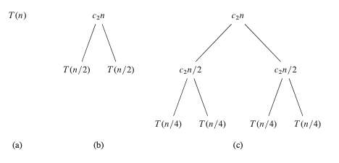
Analyzing Divide and conquer algorithms
Merge sort

Slide 20
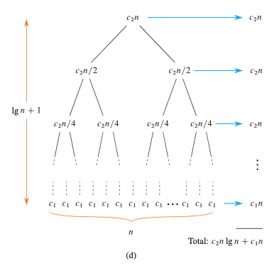
Analyzing Divide and conquer algorithms
Merge sort

Slide 21
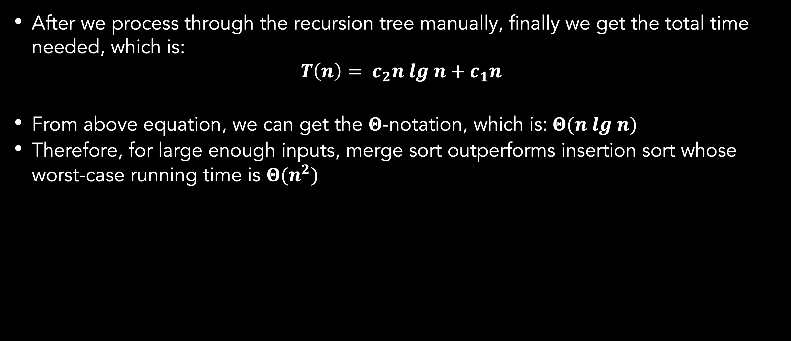
Analyzing Divide and conquer algorithms
Merge sort
After we process through the recursion tree manually, finally we get the total time needed, which is:
$$T\left(n\right)= c_{2}n lg n+c_{1}n$$
From above equation, we can get the $Θ$-notation, which is: $Θ(n lg n)$
Therefore, for large enough inputs, merge sort outperforms insertion sort whose worst-case running time is $Θ(n^{2})$

Slide 22
Summary
Analyzing an algorithm has come to mean predicting the resources that the algorithm requires.
We can use running times and order of growth to analyze an algorithm.
There are many algorithm design techniques. Insertion sort uses incremental method, while merge sort uses divide-and-conquer method.

Slide 23
Exercises
03
Illustrate the operation of merge sort on an array initially containing the sequence [3, 41, 52, 26, 38, 57, 9, 49].
Consider the searching problem:
Input: A sequence of n numbers [a1, a2, …, an] stored in array A[1:n] and a value x.
Output: An index I such that x equals A[i] or the special value NIL if x does not appear in A.
Write pseudocode for linear search, which scans through the array from beginning to end, looking for x. Using a loop invariant, prove that your algorithm is correct. Make sure that your loop invariant fulfills the three necessary properties.

Slide 24
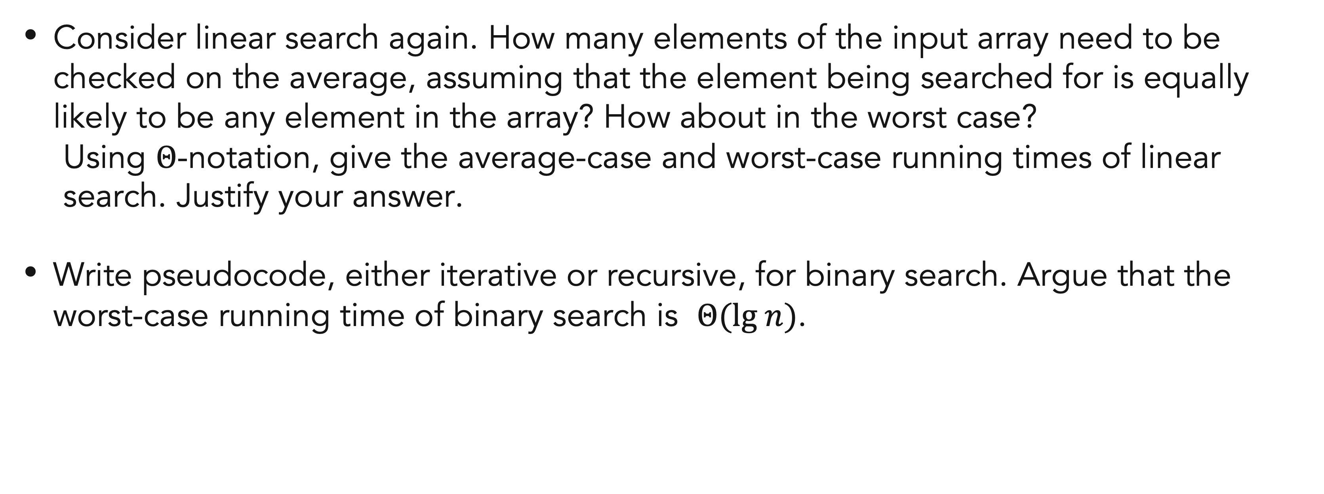
Exercises
03
Consider linear search again. How many elements of the input array need to be checked on the average, assuming that the element being searched for is equally likely to be any element in the array? How about in the worst case?
Using $Θ$-notation, give the average-case and worst-case running times of linear search. Justify your answer.
Write pseudocode, either iterative or recursive, for binary search. Argue that the worst-case running time of binary search is $Θ(lg n)$.

Slide 25
References
Thomas H. Cormen. (2022). Introduction to algorithms: Fourth edition. The MIT Press. Chapter 2.

Slide 26
Thank you
Analyzing Algorithms
September, 2023

